Slide 1
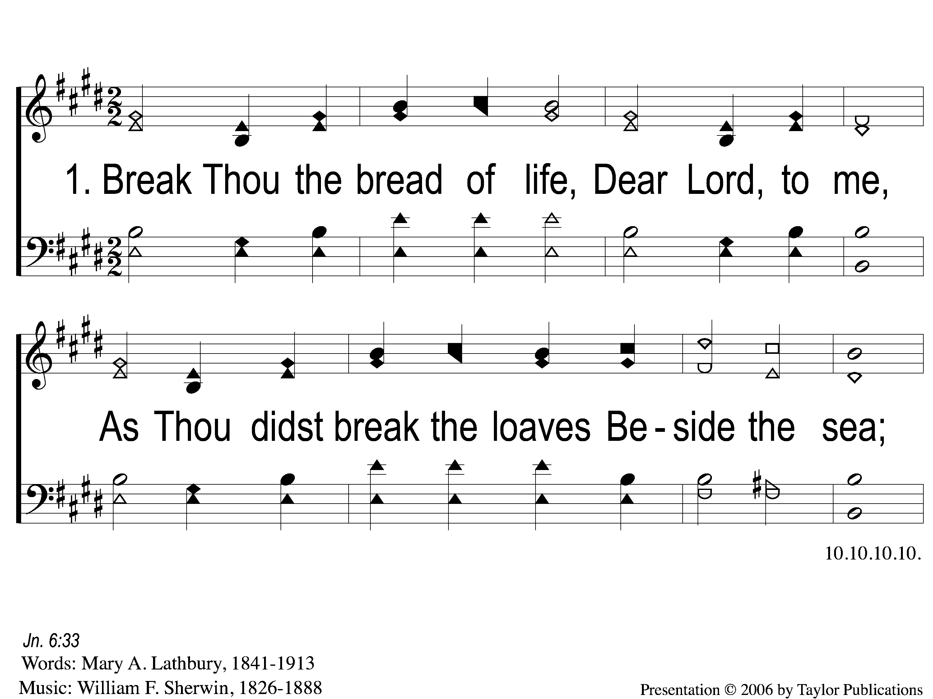
1-1 Break Thou the Bread of Life
Break Thou The Bread
51

Slide 2
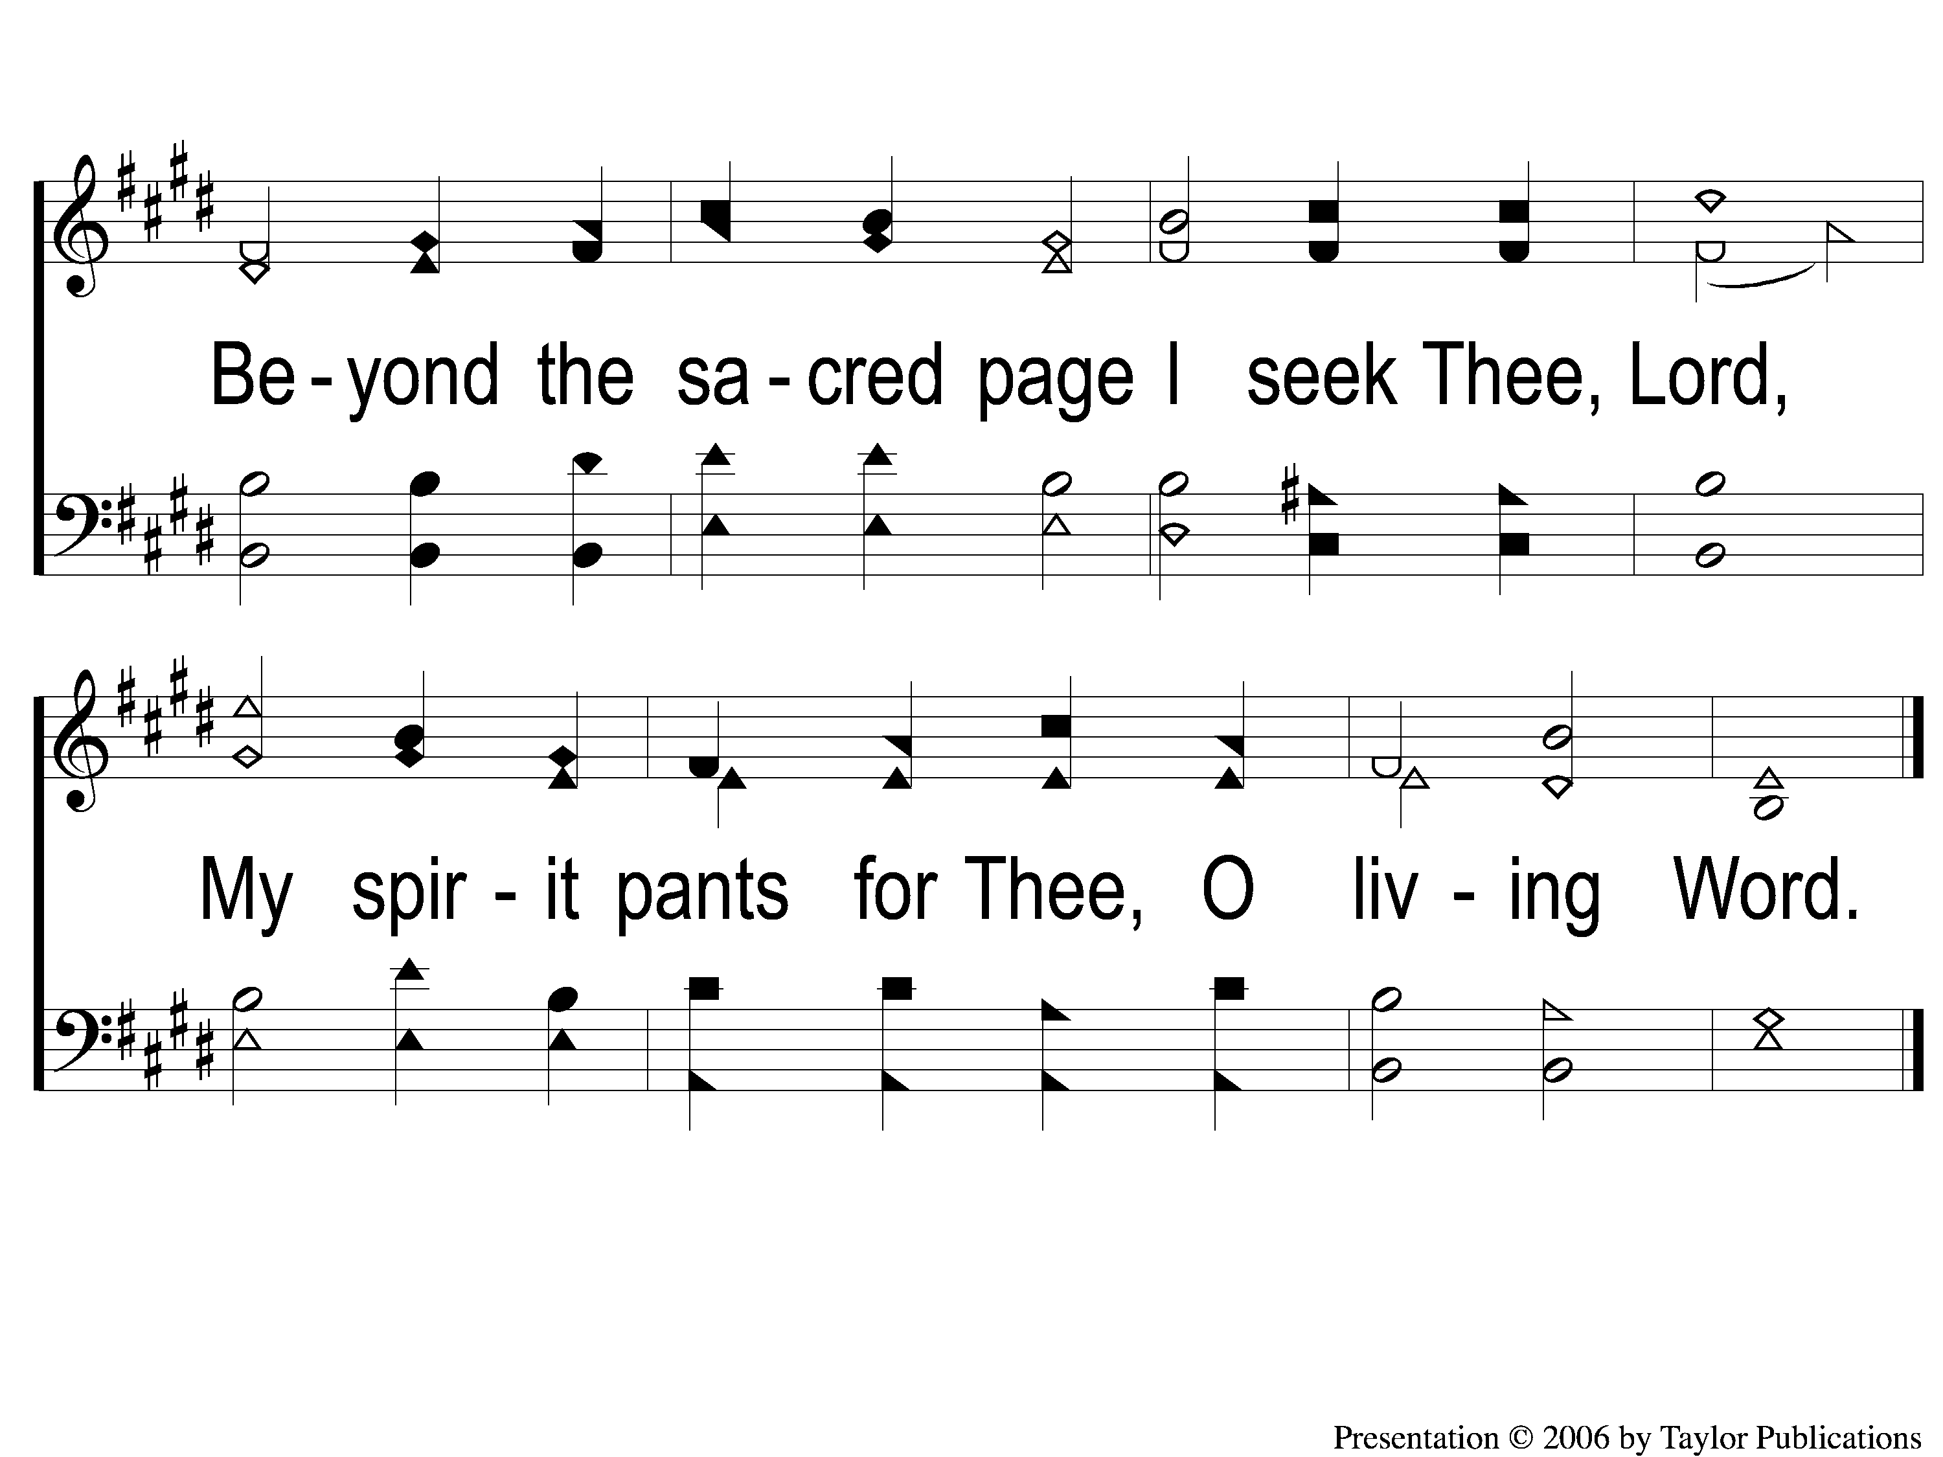
1-2 Break Thou the Bread of Life
Break Thou The Bread
51

Slide 3
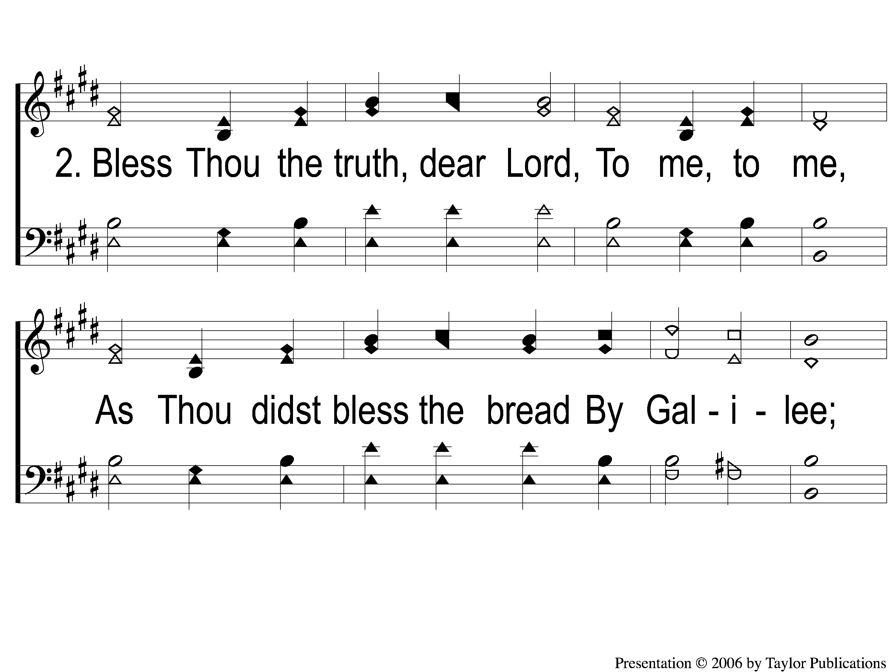
2-1 Break Thou the Bread of Life
Break Thou The Bread
51

Slide 4
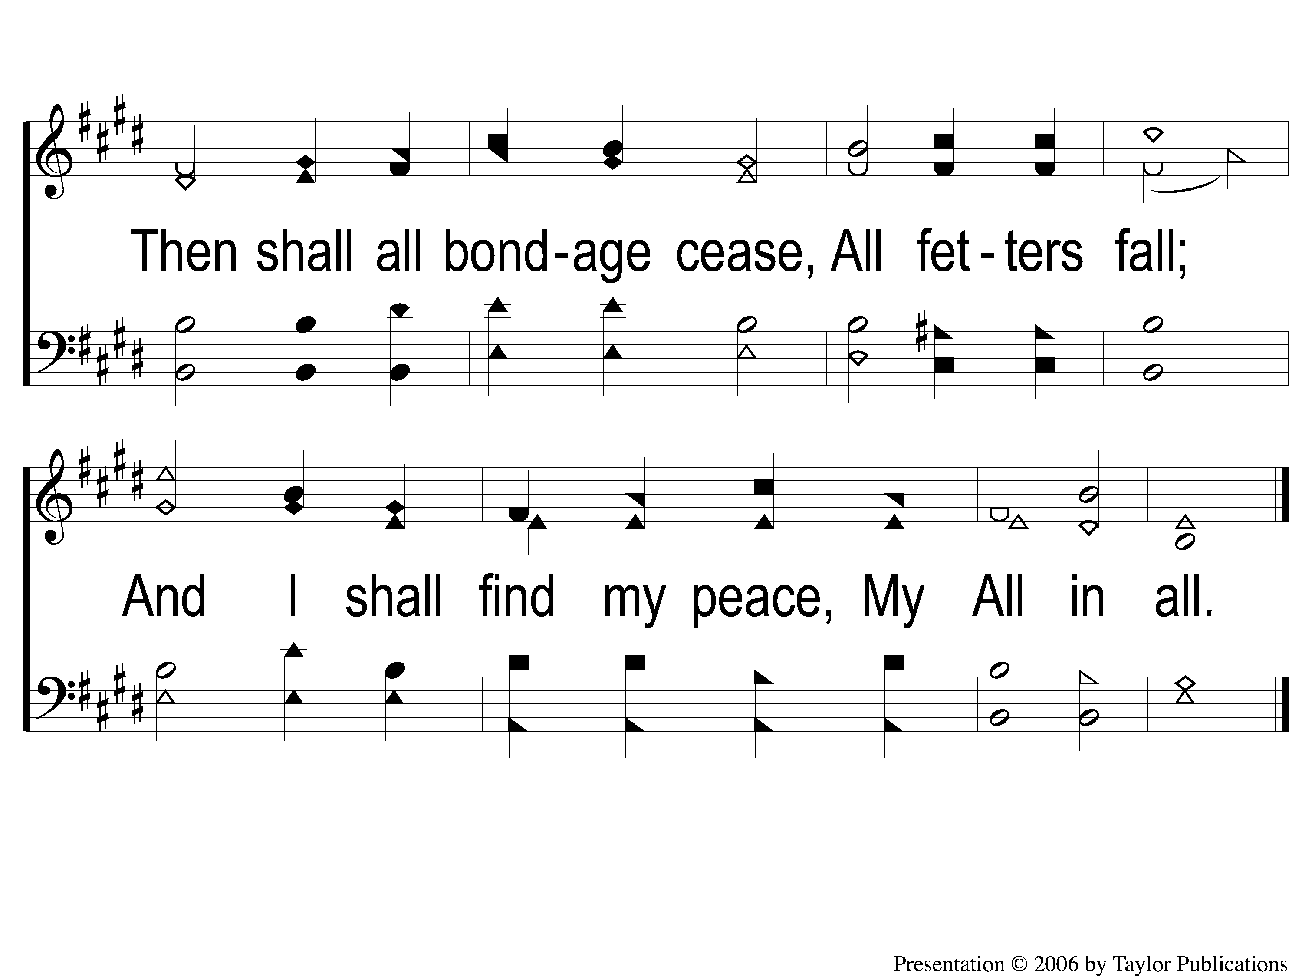
2-2 Break Thou the Bread of Life
Break Thou The Bread
51

